Slide 1
Experiential Learning in
Hospitality and Tourism
– an industry/STR perspective
EuroCHRIE 2015, Manchester Metropolitan University
Steve Hood, steve@str.com, +1 615 824 8664, ext 3315
Senior VP of Research for STR Global and Founding Director of the SHARE Center

Slide 2
STR Global (Smith Travel Research)
Recognized by many as the leader in hotel research, STR provides a benchmarking service to the industry.
STR obtains performance data from 75% of US hotels and 55% of WW hotels, including 90% of chain hotels and most significant independent hotels.
STR provides monthly, weekly, and daily STAR Reports to nearly 60K hotels. (Most GMs bonuses are related.)
STR has been in business since 1985, has offices all over the world, conducts regular presentations at international conferences, and provides a variety of products and services to a wide range of organizations in the hotel industry.

Slide 3

STR SHARE Center
“SHARE” stands for “Supporting Hotel-
related Academic Research and Education”
The mission:
  Provide universities around the world …
  with large volumes of different types …
  of hotel and tourism data, as well as related resources, …
  for research, student projects and for use in the classroom
  We work together with many international academic associations and support organizations: AHLEI, ICHRIE, EuroCHRIE, APacCHRIE, TTRA, ISTTE, AHFME, iHITA, RevME, ARES, COHREP, GHE, KAHTEA, CHME, CHEI, AMFORHT, EUHOFA, HSoD, THE-ICE, CAUTHE, La Fondacion, ANESTEUR and the Institute of Hospitality.

Slide 4
Launched in 2011, the SHARE Center has 530 member schools from 56 countries
U.S.
A-B Tech
American Public Univ System
American Univ
Appalachian State Univ
Arizona State Univ’
Arkansas Tech Univ
Atlantic Cape Community College
Auburn Univ
Ball State Univ
Baruch College
Belmont Univ
Berry College
Black Hills State Univ
Boston Univ
Bradley Univ
Bristol Community College
Buffalo State College
BYU - Hawaii
California Poly State Univ – Pomona
California Poly State Univ – San Luis Obispo
California State University - Chico
California State University – Dominguez Hills
California State University – East Bay
Cape Code Community College
Central Connecticut State Univ
Central Michigan Univ
Cheyney Univ of Pennsylvania
Clemson Univ
Coastal Carolina Univ
College Of Charleston
College of the Canyons
College of the Ozarks
Colorado State Univ
Columbia Univ
Copenhagen Business Academy (DEN)
Cornell Univ
Dakota County Technical College
Dartmouth College
Delaware County Community College
Delaware State Univ
DePaul Univ
Drexel Univ
East Carolina Univ
Eastern Michigan Univ
Emory Univ
Endicott College
Fairleigh Dickinson Univ
Ferris State Univ
Florida Atlantic Univ
Florida Gulf Coast Univ
Florida International Univ
Florida State Univ
George Mason Univ
George Washington Univ
Georgetown Univ
Georgia Regents Univ
Georgia State Univ
Grand Valley State Univ
Harris Stowe State Univ
Harvard Business School
Hocking College
Howard Community College
Husson Univ
Illinois CareerPath Institute
Indiana Univ of Pennsylvania
Intl Air & Hospitality Academy
Iowa State Univ
James Madison Univ
Johns Hopkins Univ
Johnson & Wales – Charlotte
Johnson & Wales – Denver
Johnson & Wales – Nth Miami
Johnson & Wales – Providence
Johnson County Community College
Kansas State Univ
Kapi’olani Community College
Kendall College
Kent State Univ
Kingsborough Community College
Kirkwood Community College
LaGuardia Community College
Lane Community College
Lasell College
Lehigh Univ
Longwood Univ
Loyola Marymount Univ
Lycoming College
Lynn University
Madison College
Marquette Univ
Massachusetts Institute of Technology
Metropolitan State Univ Denver
Miami Dade College
Michigan State Univ
Mississippi State Univ
Missouri State Univ
Morgan State Univ
Mt Hood Community College
Mt Saint Mary Univ
New Mexico State Univ
New York City College of Technology
New York Univ
Niagara Univ
North Carolina Central Univ
North Dakota State Univ
Northampton Community College
Northern Arizona Univ
Northern Illinois Univ
Northwestern Univ
NYIT School of Mgmt
Ohio State Univ
Oklahoma State Univ
Old Dominion Univ
Orange Coast College
Pace Univ
Paul Smith’s College
Pennsylvania State Univ
Philadelphia Academies Inc.
Pima County Community College
Pittsburgh State Univ
Plymouth State Univ
Princeton Univ
Purdue Univ
Purdue Univ – Calumet
Purdue Univ – Fort Wayne
Richard Stockton College of NJ
Robert Morris Univ
Roosevelt Univ
Saint Leo Univ
Salem State Univ
San Diego State Univ
San Francisco State Univ
San Jose State Univ
Santa Rosa Junior College
South Dakota State Univ
Southern Methodist Univ
Southern Oregon Univ
Southern Utah Univ
Southwest Minnesota State Univ
Stanford Univ
Stephen F. Austin State Univ
Stratford Univ
Sullivan Univ
SUNY Canton
SUNY Delhi
SUNY Plattsburgh
Temple Univ
Texas A&M Univ
Texas Tech Univ
Univ of Akron
Univ of Alabama
Univ of Arkansas
Univ of California - Berkeley
Univ of California – Irvine
Univ of California – Los Angeles
Univ of Central Florida
Univ of Central Michigan
Univ of Central Missouri
Univ of Chicago
Univ of Colorado
Univ of Delaware
Univ of Denver
Univ of Florida
Univ of Hawaii - Manoa
Univ of Houston
Univ of Kentucky
Univ of Maryland Eastern Shore
Univ of Massachusetts – Amherst
Univ of Memphis
Univ of Minnesota
Univ of Mississippi
Univ of Missouri
Univ of Missouri – Kansas City
Univ of Nebraska - Lincoln
Univ of Nevada – Las Vegas
Univ of New Hampshire
Univ of Hew Haven
Univ of New Orleans
Univ of North Carolina
Univ of North Carolina - Charlotte
Univ of North Carolina – Greensboro
Univ of North Carolina - Wilmington
Univ of North Texas
Univ of Pennsylvania
Univ of Pittsburgh – Bradford
Univ of San Francisco
Univ of South Carolina
Univ of South Carolina – Beaufort
Univ of South Florida
Univ of Southern California
Univ of Southern Mississippi
Univ of Tennessee
Univ of Texas
Univ of Utah
Univ of Virginia
Univ of Washington
Univ of West Florida
Univ of Wyoming
US Air Force Academy
Utah Valley Univ
Vanderbilt Univ
Virginia State Univ
Virginia Tech Univ
Walnut Hill College
Washington State Univ
Webster Univ
West Virginia Univ
Western Carolina Univ
Western Illinois Univ
Western Kentucky Univ
Widener Univ
Willey College
Yale Univ
York College of Pennsylvania
Youngstown State Univ
Non-U.S.
Akdeniz Univ (TUR)
Algonquin College (CAN)
ANGELL Akademie Freiburg (GER)
Anhui ZHONG-AO Institute of Technology (CNA)
Anqing Normal College (CNA)
Anthlone Institute of Technology (IRE)
Applied Technical School of Soochow Univ (CNA)
Arellano Univ (PHL)
Artesis Plantijn Univ College (BEL)
Asian School of Hospitality Arts (PHL)
Australian School of Mgmt (AUS)
Bandung Institute of Tourism (INS)
Bataan Peninsula State Univ (PHL)
BBI-LUX (LUX)
Beijing Hospitality Institute (CNA)
Beijing International Studies Univ (CNA)
Beijing Union Univ (CNA)
Benedicto College (PHL)
BHMS (SWI)
Tianjin Foreign Studies Univ (CNA)
Blue Mountains IHMS (AUS)
Bond Univ (AUS)
Bournemouth Univ (UKM)
Bulacan State Univ (PHL)
Burapha Univ International College (THA)
Camosun College (CAN)
Cardiff Metropolitan Univ (UKM)
Cass Business School (UKM)
Cavite State Univ (PHL)
Central Colleges of the Philippines (PHL)
Centro Escolar Univ (PHL)
Centro Superior De Hosteleria De Galicia (SPA)
Cesar Ritz Colleges (SWI)
Chengdu YinXing Hospitality Management College (CNA)
CESAE Business & Tourism School (SPA)
Chengdu Univ of Information Technology (CNA)
Chinese Univ of Hong Kong (CNA)
City Univ of Macau (CNA)
College of the Bahamas (BAH)
Conestoga College (CAN)
Cork Institute of Technology (IRE)
Cyprus Univ of Technology (CYP)
Dania Academy of Higher Education (DEN)
Don Honorio Ventura Technological State Univ (PHL)
Donghua Univ (CNA)
Dublin Institute of Technology (IRE)
Dusit Thani College (THA)
Duy Tan Univ (VET)
East China Normal Univ (CNA)
Ecole Hoteliere Lausanne (SWI)
Ecole Polytechnique (FRA)
Emirates Academy of Hospitality Mgt (UAE)
Enderun Colleges (PHL)
Erasmus Univ (BEL)
Erasmus Univ – Rotterdam (NTH)
East Univ of Heilongjiang (CNA)
ESCAET (FRA)
Essec Business School (FRA)
Eton College (CAN)
Far Eastern Univ (PHK)
First Middle Vocational School of Nanchang (CNA)
FIU – Tianjin Univ (CNA)
Fondazione Campus Studi del Mediterraneo (ITA)
Foundation Univ (PHL)
Fudan Univ (CNA)
George Brown College (CAN)
Girne American Univ (CYP)
Glion Inst of Higher Education (SWI)
Griffith Univ (AUS)
Guagua National Colleges (PHL)
Guilin Univ of Technology (CNA)
Guizhou Univ of Finance and Economics (CNA)
Haagaelia Uas (FIN)
Hainan Univ (CNA)
Haute Ecole de Gestion & Tourisme (SWI)
Haute Ecole Lucia De Brouckere (BEL)
Hazara Univ (PAK)
Hebei Voc & Tech College of Building Materials (CNA)
HEC Marbella (SPA
Hefei Normal Univ (CNA)
Heilbronn Univ (GER)
Hochschule Worms (GER)
Hong Kong Polytechnic Univ (CNA)
Hong Kong Univ SPACE (CNA)
Hotel Institute Montreux (SWI)
Hotelschool The Hague (NTH)
HR Academy (KRS)
HTW Chur (GER)
Huangshan Univ (CNA)
Huizhou Univ (CNA)
Hunan Normal Univ (CNA)
Imus Institute (PHL)
INSEAD (SNG)
Institute of Technology Tralee (IRE)
International Univ College (BUL)
ISHRM School System (PHL)
Istanbul Technical Univ (TUR)
Inst de tourisme et d’hotellerie du Quebec (CAN)
IUBH - Intl Hochschule Bad Honnef (GER)
JiangHan Univ Art & Science College (CNA)
Jiangxi Univ of Finance and Economics (CNA)
Jiangxi College of Foreign Studies (CNA)
Jinan Univ – Shenzhen (CNA)
Joji Ilagan College of Business and Tourism (PHL)
KDU University College (MAL)
Kenvale College (AUS)
King Saud Univ (SAB)
KonKuk Univ (KRS)
KTH Royal Institute of Technology (SWE)
Kyung Hee Univ (KRS)
La Consolacion College – Bacolod (PHL)
La Rochelle Business School (FRA)
Lao National Institute of Tourism & Hospitality (LAO)
Leiden Univ (NTH)
Les Roches (SWI)
Les Roches Jin Jiang Intl Hotel Mgmt College (CNA)
Leyte Normal Univ – Tacloban City (PHL)
Lillebaelt Academy (DEN)
Lincoln Univ (NZL)
Lincoln Univ College (MAL)
Lipa City College (PHL)
London School of Economics and Politics (UKM)
Luiss Business School (ITA)
Lyceum of the Philippines Univ - Batangas (PHL)
Lyceum of the Philippines Univ - Cavite (PHL)
Lyceum of the Philippines Univ – Laguna (PHL)
Lyceum of the Philippines Univ – Manila (PHL)
Macau Univ of Science and Technology (CNA)
Malayan Colleges Laguna (PHL)
Manchester Metropolitan Univ (UKM)
Manuel S. Enverga Univ Foundation (PHL)
MBA ESG Paris (FRA)
MDIS (SNG)
Meio Univ (JPN)
Milton Margai College of Education and Tech (SLN)
Mindanao State Univ (PHL)
MODUL Univ Vienna (AST)
Mount Saint Vincent Univ (CAN)
Munich Univ of Applied Sciences (GER)
Naga College Foundation (PHL)
Nanyang Polytechnic (CNA)
National Kaohsiung Univ (TRC)
National Taiwan Normal Univ (TRC)
National Univ – Manila (PHL)
National Univ of Singapore (SNG)
Neoma Business School (FRA)
New Economic School (RUS)
Ngee Ann Polytechnic (SNG)
NHTV Breda Univ of Applied Sciences (NTH)
Niagara College (CAN)
Ningbo Polytechnic (CNA)
Northeast Forest Univ (CNA)
Northpoint Academy for Culinary Arts (PHL)
Northern Iloilo Polytechnic State College (PHL)
Northwest Samar State Univ (PHL)
Notre Dame of Midsayap College (PHL)
Nyenrode Business Univ (NTH)
Oceanlink Institute Inc. (PHL)
Orebro Univ (SWE)
Otago Polytechnic (NZL)
Oxford Brookes Univ (UKM)
Ozyegin Univ (TUR)
Philippine Christian Univ (PHL)
Philippine Women’s University (PHL)
Plymouth Univ (UKM)
Podomoro Univ (INS)
Polytechnic Institute of Viseu (POR)
Polytechnic Univ of the Philippines (PHL)
Prestige Institute of Mgmt (IND)
Prince Sultan Univ (SAB)
Private Hotel School (SAF)
Professional Electronics Institute (PHL)
Pujiang Institute of Nanjing Tech Univ (CNA)
Qingdao Voc. and Tech College of Hotel Mgt (CNA)
Ramon Llull Univ (SPA)
RCU Maria Christina (SPA)
Ritsumeikan Asia Pacific Univ (JPN)
Ryerson Univ (CAN)
Saint Louis University (PHL)
Saint Mary’s Univ (PHL)
San Juan de Dios Educational Foundation (PHL)
Sant Pol Hotel School (SPA)
Sanya Univ (CNA)
Saxion Univ of Applied Sciences (NTH)
Schweizerische Hotelfachschule Luzern SHL (SWI)
Sejong Univ (KRS)
Selkirk College (CAN)
Shanghai Business School (CNA)
Shanghai Institute of Tourism (CNA)
Shanghai Trade Union Polytechnic (CNA)
Shanghai Univ of Engineering Sciences (CNA)
SHATEC (SNG)
Shannon College (IRE)
Sheffield Hallam Univ (UKM)
Sichuan University (CNA)
Skema Business School (FRA)
Sofia Univ (BUL)
Southfield Foreign Univ (PHL)
St Dominic College of Asia (PHL)
St Michael’s College of Laguna (PHL)
Stenden Univ (NTH)
Stenden Univ Qatar (QAT)
Strathmore Univ (KEN)
Sun Yat-Sen Univ (CNA)
Surigao State College of Technology (PHL)
Swiss Institute of Management (SWI)
Tamkang Univ (TRC)
Tangshan Normal Univ (CNA)
Taylor’s Univ (MAL)
Technological & Higher Education Inst Hong Kong (CNA)
Temasek Polytechnic (SNG)
Terenga Intl Hospitality & Culinary Arts Academy (NIG)
The College of Hotel Management (SRB)
The Hotel School Sydney (AUS)
THINK Education (AUS)
Tianjin Foreign Studies Univ (CNA)
Touro College Berlin (GER)
Treston Intl College (PHL)
Trinity College Dublin (IRE(
Trinity Univ of Asia (PHL)
Univ College Northern Denmark (DEN)
Univ of Amsterdam (NTH)
Univ of Angers (FRA)
Univ of Baguio (PHL)
Univ of Belgrade (SRB)
Univ of Bologna (ITA)
Univ of Croatia (CRO)
Univ of Derby (UKM)
Univ of Food Technologies (BUL)
Univ of Groningen (NTH)
Univ of Guelph (CAN)
Univ of Jordan (JOR)
Univ of Macau (CNA)
Univ of Makati (PHL)
Univ of Queensland (AUS)
Univ of Santo Tomas (PHL)
Univ of Surrey (UKM)
Univ of Stavanger (NOR)
Univ of the Aegean (GRE)
Univ of the Virgin Islands (VIS)
Univ of the West Indies (JAM)
Univ of Toronto (CAN)
Univ of West London (UKM)
Univ of Western Sydney (AUS)
Univ Sains Malaysia (MAL)
Universidad de Deusto (SPA)
Universidad de Monterrey (MEX)
Universidad Externado de Colombia (COL)
Universidad Panamericana (MEX)
Universidad San Francisco de Quito (ECU)
Universidad San Ignacio De Loyola (PER)
Universidad do Algarve (POR)
Université Paris-Est Marne (FRA)
Universiti Putra Malaysia (MAL)
UNLV Singapore (SNG)
Vancouver Community College (CAN)
Vancouver Island Univ (CAN)
Vatel (SWI)
Vern Univ of Applied Sciences (CRO)
Victoria Univ (AUS)
Vienna Univ of Applied Sciences (AST)
Vilniaus Kolegija (LIT)
Wavecrest College of Hospitality (NIG)
West Visayas State Univ – Lambunao (PHL)
West Visayas State Univ – Pototan (PHL)
Western Philippines Univ (PHL)
Western Univ (CAN)
Whitireia New Zealand (NZL)
William Angliss Institute (AUS)
Wuhan Polytechnic Univ (CNA)
Wuhu Institute of Technology (CNA)
Yangzhou Univ Tourism & Cuisine College (CNA)
Yasar Univ (TUR)
Yeditepe Univ (TUR)
Yarmouk Univ (JOR)
Zamboanga State College of Tech (PHL)
Zhejiang Agriculture & Forestry Univ (CNA)
Zhejiang Univ City College (CNA)
Zhejiang Yuetiu Univ (CNA)

Slide 5
What’s included in a SHARE Center membership?
Hotel and Tourism Data
Hotel Performance (Occupancy, ADR, RevPAR) data
Hotel Profit & Loss (accounting/profitability) data
Hotel Pipeline & Supply (development) data
User-defined Destination/Tourism reports
Hotel Census data (attribute information)
Hotel Company information
Property & Room Counts
Forecast reports
Hotel Sales Transaction data

Slide 6
And in addition to Data …
Training programs with supporting material (applications)
Research related support – collaboration, special data requests, help merging/correlating third party data
Access to articles – HotelNewsNow.com our sister company
Global Industry publications – country, continent, cities
Speaker support for Deans, Directors and Department Heads
Sample reports and hotel industry reference information
Student competitions
Webinars for faculty or students
Educator forums connecting academia with industry
Online community

Slide 7
Industry Relevant Training Programs
Current:
Hotel Industry Analytical Foundations
Hotel Math Fundamentals
Property Level Benchmarking
Hotel Industry Performance Reports
Tourism Industry Analytics and Tourism Related Data - new
Hospitality and Tourism Future Trends - new
How to Conduct a Market Study, Impact Analysis, or Feasibility Study - new
Data and Resources Available for Research and Education
In progress:
Revenue Management, Hotel Accounting, Hotel Development, Forecasting, Hotel Industry Economics – an STR perspective
Excel for Hotel Industry Professionals
Hotel and Tourism Definitions and Terminology
International Geography for Hotel & Tourism Professionals

Slide 8
Student Competitions
Next year, we would like to conduct a European Market Study Competition. Let me know if you are interested.
We recently launched the first Market Study Competition in North America.
Student groups from 28 different schools have selected cities and have submitted comprehensive Market Studies.
Training, samples and data were provided. A PowerPoint (200+ slides) and Brainshark were made available.
Groups will deliver presentations at the New York Hotel Show (November 2015) to industry professionals. Winning teams will be recognized ($1000 prize for first place).

Slide 9


Certification in Hotel
Industry Analytics
In 2012, we launched the “Certification in Hotel Industry Analytics” (CHIA) jointly with ICHRIE and AH&LEI.
Over 4,000 undergraduate and graduate students, as well as professors have received the CHIA certification.
45 free Train-the-Trainer sessions have been conducted for over 1000 professors. Upcoming in Netherlands and Europe.
Qualifying students and professors receive certificates and can use the “CHIA” designation on business cards/resumes.
Hotel companies are starting to ask for CHIA-certified students. We’ve received great testimonials from students related to the CHIA and their first jobs. More info available.

Slide 10
New – Abbreviated Version of the CHIA –
Hotel Industry Foundations & Introduction to Analytics
In 2015, we launched the HIFIA, targeted at two-year colleges, technical schools and schools in developing areas of the world.
The HIFIA is shorter, 5 modules instead of 16 in the CHIA.
It is easier, less emphasis on math and reports, but it still builds a hotel industry foundation and an appreciation for analytics (hotel math is not rocket science).
The HIFIA is personalized for areas of the world. It is translated into Chinese and is being translated into Spanish.
More information and an outline are available.

Slide 11

HotelNewsNow.com – Academic Support
www.hotelnewsnow.com is a free electronic
news service focused on the global hotel
industry, including performance trends,
conference updates and hot topics, with a
search capability. Info available on how
professors are using HNN in the classroom.
We have launched a new program “SHARE
News Now” where professors are invited to
submit industry relevant articles (academic research translated for practitioners, no sigmas/epsilons) to communicate with industry.
Articles will be featured in HotelNewsNow.com where thousands of industry professionals will be able to download your full research and dialogue with you regarding your findings.

Slide 12
We would be delighted to have you and your university involved in the SHARE Center!
Let us know if you are interested, sharecenter@str.com.
We offer year-long complimentary trial memberships, so schools can have an introduction to the data and resources.
To get started, there is a short enrollment form to fill out. The rules are very simple.
After that, there are nominal membership fees. We are sensitive to budget challenges. We never want a school to miss out due to financial issues. Let us know if we can help.

Slide 13
Experiential Learning
Over the last four years, I’ve had the privilege to work with professors and see how they have used data in the classroom
“I’m not sure exactly what it is,
but I think I am one!”

Slide 14
Here are some things we have done …
In the CHIA certification training, we suggest over 20 different application exercises to practice and apply the content.
Last year we created a PowerPoint, “H&T Future Trends” that identifies current issues, hot topics and problems/challenges of the hotel and tourism industry, emphasizing industry relevance.
Last year we also created a resource to help professors conduct nearly 30 different types of student projects.
This year we created a “How to Conduct a Market Study” training. (We will expand this to cover impact analyses, feasibility studies and other popular H&T research projects.)

Slide 15
Here are some things we have learned from you …
Professors are using our data and related resources in a variety of creative ways to provide students with hands-on experience working with live hotel and tourism industry data. I’ll share some examples.
We’ve done a bad job compiling these examples. That’s a goal for 2016 (online community).
As a company, STR conducts numerous research projects ourselves, (but not as much as we would like).
Our customers: hotel companies, tourism organizations, and consultants use STR data to perform a wide range of research.

Slide 16
Examples of Experiential Learning
Observations
Ways I think we are helping
What else we can do together?

Slide 17
Observations regarding Experiential Learning – top 5
Familiarity with data is priceless. (Examples will follow)
Comfort level increases as you graph/visualize data. Numbers in a table become real actionable information.
Data taxonomy/levels: analyze (understand) → interpret (strategic/improvement) → communicate (impart/explain, Cambra)
Critical for hospitality and tourism education to be industry relevant (terminology, definitions, formulas, methodologies, reports, hot topics, current challenges)
Students can benefit immensely from hands-on experience working with live hotel & tourism industry data, studying real situations and solving actual problems (same data they will be using in a hotel, company, or tourism organization)

Slide 18
Familiarity with data is priceless - examples
Running 12-month data versus monthly data
Actual values versus percent changes
Market breakdowns impact on total market

Slide 19
Not rocket science!
Supply and Demand equates to Occupancy
Occupancy impact upon ADR (pricing)
Occupancy and ADR add up to RevPAR

Slide 20
What happens in economic cycles?
Economic cycles impact on group/transient business
Raw data (Sup, Dem, Rev) versus KPIs (Occ, ADR, RevPAR)

Slide 21
Nothing compares to hands-on experience working with live industry data
Pipeline activity historic and future, adds up to future supply (forecasting)
Accounting Profit & Loss data over time and for different class hotels

Slide 22

How to Conduct a Market Study, Impact Analysis, or Feasibility Study brand new!

Slide 23
How to Conduct a Market Study - Description
Comprehensive training program – PowerPoint with over 200 slides, also a 2-hour Brainshark (PP with audio)
Thorough review of typical hotel industry research projects, including examples, objectives, alternatives and exceptions.
Detailed description of a variety of industry reports and data files available for research projects.
Sample market study for a typical city.
Access to data so that you can split class into groups, assign or have them select specific geographic areas and then obtain a wide variety of reports with data specific to the area selected.

Slide 24
Excerpt/Sample Application – Which research projects utilize which types of data?
Types of data / Research | Market Study | Impact Analysis | Feasibility Study
Monthly and daily performance data | X | X | X
Profit and Loss data | X | possibly | critical
Past and future development data | X | X | X
Size and structure information on hotels | X |  | X
Property attribute data | X |  | X
Projected performance data | X | possibly | X

Slide 25
Sample Market Study – Components:
General Makeup
Current Statistics
Trended Data
Economic Cycles
Market Breakdown
Comparable Markets
Types of Business
Daily Data
Pipeline Data
Profitability Data
Forecast Data

Slide 26

Hospitality
and Tourism
Future Trends
new!
Over 100 slides on current issues, hot topics and industry challenges
Also industry relevant research ideas for professors and students
Updated on regular basis, downloadable from SHARE Center Dropbox

Slide 27

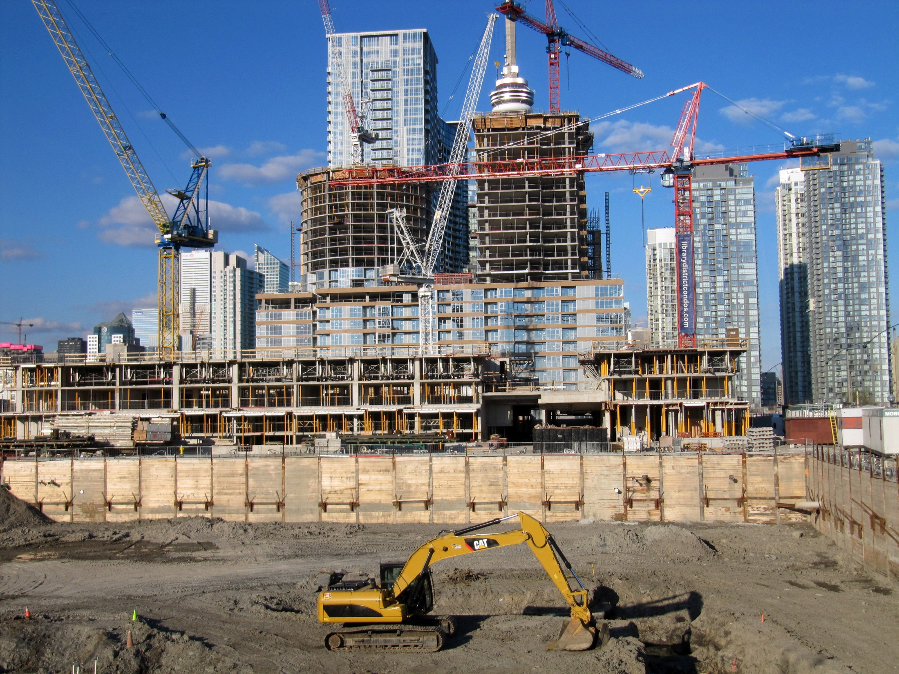

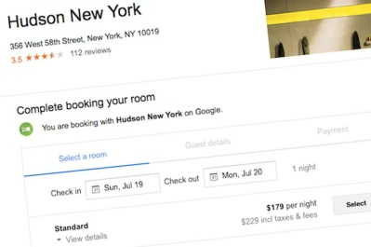

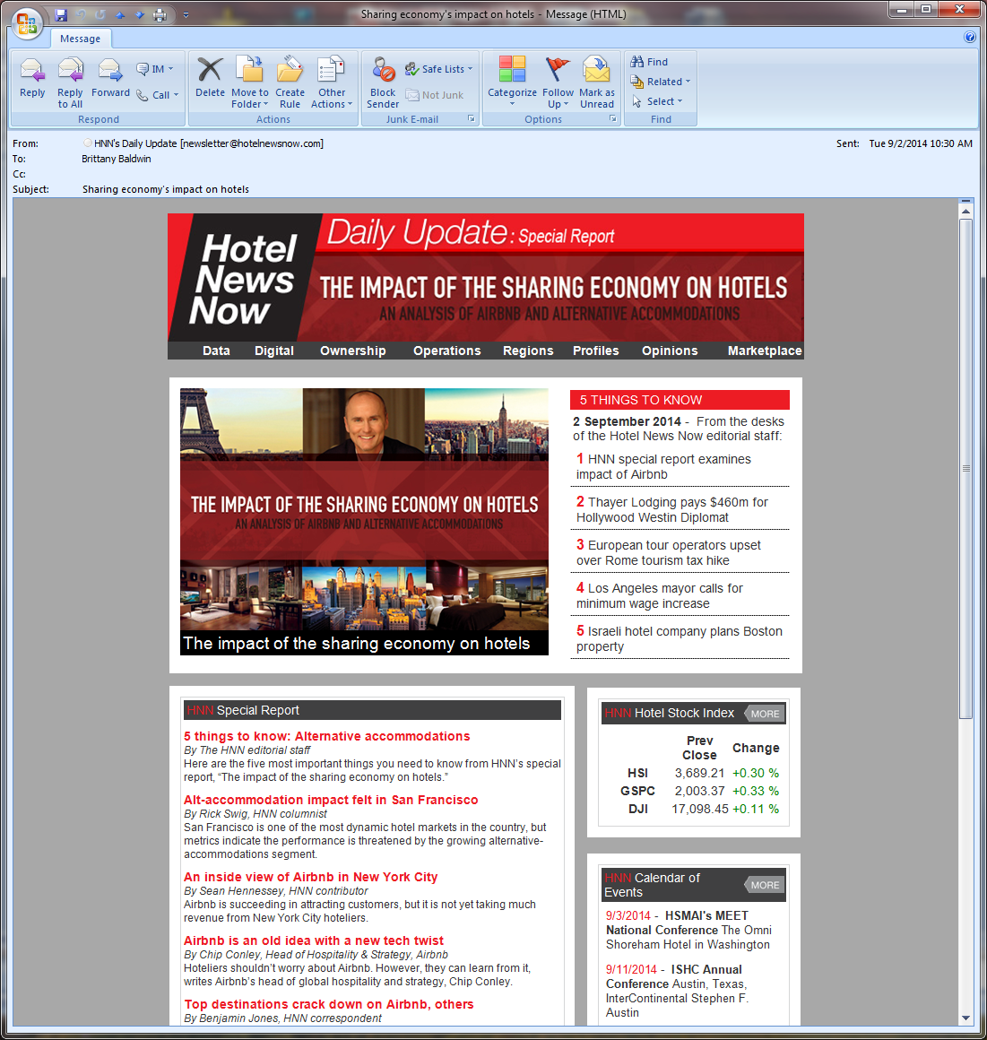

Future Trends in Hospitality and Tourism
Performance Trends
Development Trends
Hotel Branding
Revenue Management
Technology Trends
Sharing Economy
International Tourism Trends
Conclusion - “Unprecedented time of oppor-
tunity for Hospitality & Tourism education!”

Slide 28



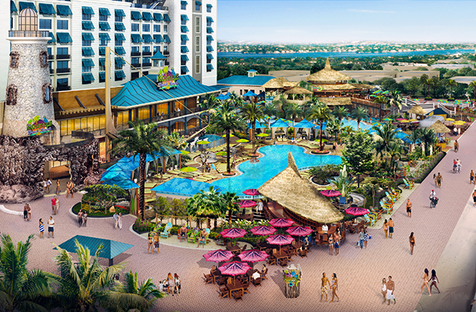
Excerpt from Branding - Collaboration Examples in the Hotel Industry
National Geographic – 24 hotels
Virgin Hotel – Nashville, Tennessee, USA
Bulgari Hotel – Milan, Italy
Margaritaville – Hollywood, FL, USA

Slide 29
Certification in Hotel
Industry Analytics
The CHIA training program covers critical industry foundations (terminology, formulas and methodologies, analytical skills) and includes many application exercises

Slide 30
CHIA Application Exercises – sample list
Compare the hotel industry in different areas of the world
Contrast various players in the hotel industry (chain, company)
Determine benchmarking alternatives/advantages in the hotel industry
Determine the best/most accurate competitors for a subject hotel (choose a comp set)
Analyze raw property/comp set monthly performance data
Evaluate life-like performance data of different sample hotels
Work with daily and group/transient data to find improvement areas
Explain positive and negative impacts upon percent changes
Analyze industry performance data for a geographic area

Slide 31
Student Projects
Last year we created a resource to help professors conduct nearly 30 different types of student projects, including foundations, step-by-steps, data and suggested deliverables.

Slide 32
Student Research Projects
  Hotel-Related Overviews
Local Market Overview
Comparable Market Analysis
Tracking Ongoing Performance
Existing Supply Analysis
Conversion Activity Analysis
Future Supply Analysis
Profitability Study
Destination Forecasting
  Impact Analyses
Weather-Related
Sporting Event
Holiday Shift Study
Crisis-Related
Potential Special Event
New Attraction
Selected Hotel Comparative Study
Correlating Hotel & Other Travel Data
Development Potential
Economic Cycle Comparative Analysis
  Market Segment Research
Weekday/Weekend and DOW Analysis
Group versus Transient Analysis
Seasonality Analysis
School Vacation/Schedule Analysis
Compression/Overflow Analysis
Sellout Night Analysis
  Guest/Visitor Studies
Traveler Origin/Intention Analysis
Visitor Profile Analysis
Guest Satisfaction/Review Analysis
Destination Branding Study

Slide 33
Outside the box!
H&T professors are among the most creative when I see the unique ways they utilize data/resources.
Let us know other things you are doing!

Slide 34
Examples of H&T professors creatively using data:
Analyze hotel industry publications around the world (continents, subcontinents, countries, cities)
Simulate a tourism organization (track special events, research, press releases)
Prepare students for simulation exercises (RedGlobal, HOTS)
Use a Destination Report to help teach forecasting
Compare P&L/accounting data for different types of hotels
What is the best calendar for the hotel industry?
Use hotel longitude/latitude data with GIS program
Study modeling with hotel industry data
Correlating STR performance data with 3rd party data (review, guest satisfaction, air/arrival, employee/HR, survey)

Slide 35
STR Examples
research we have done as well as projects performed by consultants, hotel companies and tourism organizations with STR data

Slide 36
Additional Research examples – ideas for you
Compression/Overflow
Group/Transient (change in business mix)
School vacation (impact of switch)
Seasonality (ADR changes, shoulder months)
Gas price (impact of in/decrease)
Sandy and Katrina (hurricanes)
Ash cloud (cancellations, airport hotels)
Olympics, World Cup, Expo (positive or negative)
Gulf Oil Spill (tourism loss versus side effects)
New Convention Center (potential gain)
National Parks (mountains versus beaches, drive-to holidays)
Impact of government business and shutdown

Slide 37
Some observations and ideas – hopefully they’ve helped
Four years ago ….
What else can we do together?
Let us know how we can help.
Steve Hood, steve@str.com
+1 615 824 8664, extension 3315

Slide 38
More detail regarding each of the projects mentioned …

Slide 39
Certification in Hotel Industry
Analytics - Application Exercises

Slide 40
1. Compare the hotel industry in different areas of the world
Compare countries or cities from a hotel industry perspective
What are the geographic subsets within the country (cities, regions) or city (neighborhoods)?
What are the class breakdowns of hotels within the country or city (how many Luxury, Upscale, Midscale, Economy)?
What are the most popular brands and the chain versus independent percentage?
What type of development activity is going on and how is development changing?

Slide 41
2. Contrast the various players in the hotel industry
Identify hotel industry players as chains, parent companies, management companies, owners, asset management companies, soft brands, marketing groups, REITs or tourism organizations
Which chains are related to which parent companies and which chains are in which Scale groups (Luxury, …)?
Analyze historic activity related to players. What do you learn from new brands/emphases? Which players are in the news and why? What kind of recent acquisition activity?
How do players differ in different areas of the world?

Slide 42
3. Determine the value and alternatives related to benchmarking in the hotel industry
Pretend you are a owner of a hotel company with 100 hotels.
Create a plan to bonus or otherwise incentivize your general managers.
How will your plan fairly compensate GMs during economic downturns and recoveries?
How will your plan fairly compensate GMs of nice/new hotels versus not so nice/older hotels in a variety of countries? (Create a similar plan to handle regional or brand managers.)

Slide 43
4. Determine accurate competitors of a subject hotel (who is the comp set?)
Review basic hotel census data to determine potential competitors (4 P’s – Proximity, Pricing, Product and Participation from the CHIA training)
Confirm pricing data via the internet (brand.com, OTAs)
Compare web sites of competitors (target customer).
Analyze product detail (amenities, restaurants, meeting space). Could even visit/interview possible competitors.
Should there be multiple comp sets? (weekday/weekend, group/transient, local versus regional, special niches)

Slide 44
5. Analyze raw property and competitor monthly performance data over time
Obtain a data file with multiple months of subject and comp set Supply, Demand, and Revenue. (same as companies)
Enter formulas and compute Occupancy, ADR, RevPAR, Indexes (Yield, Penetration) and Percent Changes.
Graph raw data, KPIs, actual values, indices and percent changes.
Correlate Supply and Demand to Occupancy, Occupancy to ADR, Occupancy and ADR to RevPAR.
Compute running month (12-month moving average) and graph to compare to monthly data (seasonality).

Slide 45
6. Work with daily or group/transient data to find areas of improvement for a hotel
Obtain a sample raw property and comp set daily data file or a raw Segmentation data file. Enter formulas to compute metrics.
Analyze daily data by day of week or by weekday/weekend to find possible areas of improvement for a specific hotel.
Analyze Segmentation data (Group, Transient, Contract) to find areas of improvement.
Analyze daily data during holidays or special events from year to year. Analyze Segmentation data for conferences. Make recommendations related to pricing and marketing.

Slide 46
7. Analyze performance of sample hotels
Obtain life-like STAR Reports for a range of hotels (Luxury-Economy, good and bad performers).
Have students analyze various types of performance data found in the reports to determine subject hotels position compared to the comp set and market (SWOT).
Identify areas of possible improvement. Compile a list of questions for the hotel management, issues to be investigated, possible recommendations.
Develop a strategy that could be implemented, future suggestions, ideas that could be considered.
Present findings and communicate a plan to the group.

Slide 47
8. Case scenario – positive and negative impacts upon percent changes
Pretend that you are a general manager, you have just received your monthly STAR report and you are reviewing your performance. The percent changes are different than what you expected.
Review all of the various events and situations that can positively or negatively affect your percent changes
Compile a checklist of items and indicate the type of affect depending upon whether it happened this year or last year.
Prepare a presentation for industry professionals and obtain their feedback based upon real-life experience.

Slide 48
9. Analyze industry performance data for a specific geographic area
Obtain one or more Trend Reports for cities, countries or specific regions of the world.
Analyze the monthly performance data over time to determine trends in your area.
Graph the performance data for your area: raw data and KPIs, actual values and percent changes, monthly and twelve month numbers.
Obtain Pipeline Reports and analyze past and future development activity in the geographic area.
Obtain HOST/Profitability Reports and analyze P&L metrics in the area.

Slide 49
Sample Student Projects

Slide 50
10. Determine comparable markets for a subject market
Obtain a variety of hotel related data (performance, pipeline, size and structure, hotel census) for a subject city and then a large variety of similar cities.
Obtain external data as well (demographics, businesses, attractions).
Compare the data of the various cities to find similar markets to the subject.
Select a small group of the best comparable markets.
Create a presentation and defend your decisions.

Slide 51
11. Conduct a development analysis
Have students select different geographic areas (countries, subcontinents or continents).
Obtain hotel census/attribute data and raw Pipeline data for the geographic area.
Analyze the hotels that have opened in the past several years (which scales, which markets, which brands, what time periods).
Analyze the hotels that will be opening in the next several years (same questions).
Graph the past and future data including projected Supply for the area. Prepare presentation with recommendations for industry and development professionals.

Slide 52
12. Analyze conversion activity in a specific geographic area
Obtain Pipeline Reports for a specific geographic area such as a city or country.
Review the conversion activity in the area over the last year and 5-year time period.
Which hotels have converted to which other hotels, which brands have converted to other brands and which scales (including independents) have converted to other scales?
You can include data on hotel opens and closes.
What does the reveal about the area? Graph the data and prepare apresentation.

Slide 53
13. Conduct a profitability analysis
Have students select one or more groups of hotels
Obtain HOST/Profitability participation data and determine a consistent sample and similar hotels.
Obtain P&L accounting data (HOST/Profitability reports) for the group(s) of hotels for multiple years
Analyze revenues, expenses, and profitability hotel census/attribute data and raw Pipeline data for the geographic area.
Compare various revenues/expenses (room, F&B, others) over time (economic cycles).
Compare profitability of different groups of hotels

Slide 54
14. Contrast performance in economic cycles
Have students select one or more geographic areas or groups of hotels (top markets vs. non-top, metro vs. non, coast vs. inland, drive-to, …).
Obtain performance (and profitability) data over a long period of time (multiple cycles).
Compare various metrics for different cycles and for different groups of hotels (how did one cycle compare to another?, how was one group of hotels impacted vs. another?)
Indicate peaks, valleys, recovery times, cycles (pos/neg).
Summarize findings and present with lessons to be learned.

Slide 55
15. Analyze sellout night data for a specific market or sample hotel
Obtain daily performance data for a specific market (or user-defined group of hotels) or for a single sample hotel
Determine average occupancies for months (Jan, Feb, …) for each year or for multiple year. Determine average annual occupancies for different years.
Determine the number of sellout nights within each year and for each day of week per year.
What does the sellout night data tell you about the market, group of hotels or sample hotel?
Compare ADRs on sellout nights vs. non-sellout nights.

Slide 56
16. Conduct a market study
Have students select different cities to analyze the hotel industry in that specific area
Obtain hotel industry data, for example: property and room counts (market by geographic/non-geographic areas), monthly performance data (for the city, subsets and comparable markets), group/transient data, hotel census/attribute data, Pipeline data, and possibly Profitability data.
Analyze and graph the various types of market data. Samples are available.
Create a presentation, including what makes the market unique, industry takeaways, and future issues.

Slide 57
17. Conduct an impact analysis
Identify a specific event, many different types (sporting, weather, political, attraction, conference), past or future
Identify the geographic area(s) impacted, direct and indirect, comparison areas if needed
Determine the date ranges for the impact and the comparable time period(s)
Obtain daily (or monthly) data for one or more specific geographic areas for multiple time periods
Estimate the impact (demand, revenue, ancillary revenue)
Compile finding and communicate. What are takeaways?

Slide 58
18. Conduct a feasibility study
Identify a potential hotel development project. This could be very specific (specific class hotel in specific geographic area) or open ended (what hotel in what area)
Obtain Trend, Pipeline and P&L (also forecast) reports for the specific area and class of hotel (or multiple if open ended). Obtain external data (business, economic, demographic)
Analyze the various types of data related to performance, development and profitability.
Compile the data in the form of a presentation to a potential investor. Include recommendations, alternatives, and concerns.

Slide 59
Outside the box!

Slide 60
19. Use hotel industry publications to review performance data for a continent
Obtain Hotel Reviews for different continents
What are the best and worst performing cities and countries in each continent and sub continent?
What are the various performance trends in different areas?
Compare data for multiple time periods.
Review currency affects by comparing metrics such as ADR, RevPAR and Revenue in local currency versus constant currency

Slide 61
20. Simulate a tourism organization
Create groups of students and have each group select a city (local or farther away).
Have each group create a Destination report (user-defined industry segments and groups of hotels related to their city, multiple pages).
Set up the report with STR and start receiving each week or month.
Review the performance metrics related to the city (types of business, special events, conferences).
Prepare regular press releases describing hotel performance over a time period. Then create a summary analyzing recent performance with graphs and future recommendations.

Slide 62
21. Use a Destination Report to teach forecasting
Together with the class create a Destination report (user-defined industry segments, multiple pages) for a city near or far.
Set up the Destination report with STR and start receiving each week or month to see performance results related to events.
Present training on forecasting and demonstrate by forecasting weekly numbers for the selected city, reviewing results each week.
Break students into groups and have them continue to forecast. Track results of each group over time and the average of all.

Slide 63
22. Compare accounting profit and loss data for different hotels
Obtain HOST/Profitability Reports for different groups of hotels: full service versus select service, by scale (Luxury – Economy), different types (urban, convention, resort) or different geographic areas.
Compare the revenue types and ratio to sales percentages.
Compare distributed and undistributed expenses, including payroll and cost of goods sales.
Compare profitability (GOP, NOI, EBIDTA, fees, and fixed charges.

Slide 64
23. What is the best possible calendar for the hotel industry?
You could do this for a specific country or another geographic area.
Identify holidays and special events that favorably impact the hotel industry.
Analyze daily hotel performance data to how hotel revenues differ on each day of the week for each special event.
Determine the best (and worst) possible calendar, for example this holiday should always fall on a Friday, this event should always be in this month.
Compute the revenue difference of the fantasy calendar. What are the takeaways for an industry professional?

Slide 65
24. Using hotel latitude/longitude data with GIS (geographical Information systems) programs
The STR hotel Census database includes latitudes and longitudes. Geocoding accuracy is very high in developed countries.
You can graph hotels on maps
You can create “heat maps” including performance data.
You can use programs such as Tableau to display data in geographical format
Samples are available

Slide 66
25. Study “modeling” with hotel industry data
Select a specific geographic area and determine the number of participants and non participants for performance and/or profitability data in various sub categories (geographic and class/level).
Obtain performance and/or profitability data for the large geographic data and for the various subsets of hotels within the larger geographic area.
Create a plan to model (estimate) the data of the non-participants by using actual data of the participants.
Use the methodology to recalculate the performance and/or profitability of the larger geographic area and defend the accuracy of the modeled data.

Slide 67
More information about the STR SHARE Center and the certification programs …

Slide 68
Benchmarking 101: my hotel vs. the competition
How STR serves the hotel industry and how most GMs are bonused

Slide 69
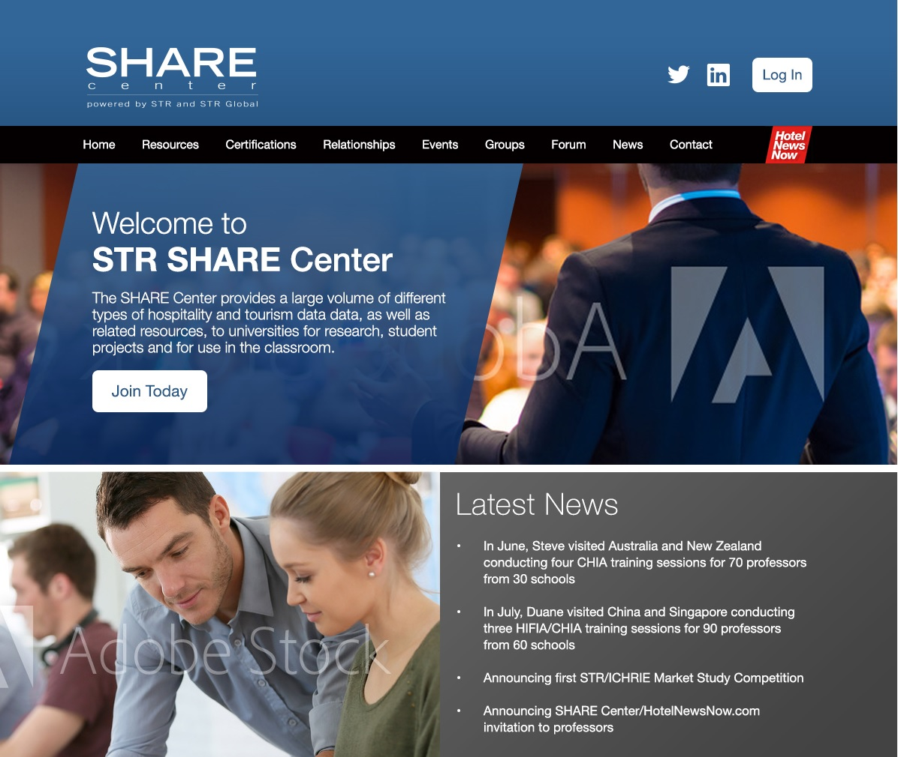
Launching an online community later this year
Groups focused on topics such as tourism analytics and revenue management
Connecting academia and industry, helping to bridge the communication gap

Slide 70
Academic Presentations
STR staff conduct presentations all around the world, about one every business day of the year. Academic samples include:
  Hotel Industry Overview – performance and development trends for any area of the world
  Hospitality and Tourism Future Trends
  Hotel and Tourism Data Available for Research
  What is Hotel Industry Analytics?
  Aligning Research with Hotel Industry Hot Topics and Current Issues
  The Effective Presentation of Hotel and Tourism Industry Data
  Industry Relevant Hospitality and Tourism Research and Education
  How to Conduct a Market Study, Impact Analysis, Feasibility Study
  Using Student Projects to Help Improve H&T Education
  Bridging the Gap Between Industry and Academia

Slide 71
Dictionary of hospitality terminology – a preview
chain, parent company, management company, owner, asset management company, marketing group, soft brand, REIT, operation, corporate, franchise, independent, continent, sub-continent, country, market, submarket, UNWTO, scale, class, location, extended stay, types, boutique, lifestyle, competitive sets, four P’s to creating, comp set rules, raw data, supply, demand, revenue, monthly/daily data, key performance indicators, occupancy, ADR, RevPAR, percent change, point change, YTD, running 12/3-month, 12MMA, MTD, running 28-day, weekday, weekend, comparable days, aggregated data, include vs. exclude, index, penetration, yield, index percent change, ranking, bandwidth, sufficiency, full availability, out of order rooms, seasonality, modeling, consistent sample, open/close, add/drop, conversion, local currency, exchange rate, currency fluctuation, constant currency, GOPPAR segmentation, group, contract, transient, SMERF, additional revenue, day of week, RevPAR positioning matrix, pipeline, in construction, under contract, planning, final planning, unconfirmed, existing supply, HOST, profitability, P&L, ratio to sales, amount per occupied room, amount per available room, GOP, NOI, destination report, comparable market, multi-segment page, property and room count, census vs. sample, hotel census database, forecast

Slide 72
Certification Details
A comprehensive training package is provided with PowerPoints, applications, quizzes, and case scenarios.
The cost of the certifications for students is just $75 USD (free for professors, $300 for industry professionals).
Testing is administered by EI. Hardcopy or online exams are available. 50 multiple choice questions and a minimum passing score of 70%. The passing rate is 75-80%.
Schools are using a variety of formats to present the CHIA training: different classes, optional or mandatory, grad and undergrad.
The certification is being offered to lodging, tourism and other hospitality students.

Slide 73
Certification Description
This is the leading hotel-related certification for undergraduate and graduate students in Hospitality and Tourism programs (or industry professionals).
This recognition provides evidence of a thorough knowledge of the foundational metrics, definitions, formulas, and methodologies that are used by the hotel industry.
Recipients have proven that they can “do the math” and interpret the results.
They have demonstrated an ability to analyze various types of hotel industry data and to make strategic inferences based upon that analysis.
Certification also confirms a comprehensive understanding of benchmarking and performance reports.
Designees have a grasp of the current landscape of the hotel industry, including relevant current events.
Achieving this distinction announces that you have a place among the best graduates in your profession and opens the doors to future career opportunities.

Slide 74
Certification Content
Hotel Industry Analytical Foundations
  Who are the players, affiliations, size and structure, categorization basics, benchmarking in the hotel industry, competitive sets, creating, changing, rules, stats, hotel industry lingo, industry hotel topics
Hotel Math Fundamentals, the metrics used by the Hotel Industry
  Foundational metrics, definitions, formulas (Supply, Demand, Revenue, Occupancy, ADR, RevPAR, % changes, multi-year, index, yield, penetration, market share, ranking), methodologies, interpreting the numbers, Excel-based
Property Level Benchmarking (STAR Reports)
  Step though each page of a monthly, weekly, and daily STAR report; how do hotel managers use the data to make strategic decisions, hints, questions, case scenarios
Hotel Industry Performance Reports
  Step through each page of each ad-hoc report (Trends, Pipeline, HOST, Forecast, Destination Reports, others), explain all the metrics and how they are used, hints

Slide 75
CHIA Train-the-Trainer Sessions
Free Train-the-Trainer sessions are provided to prepare professors to present the training to their students.
Upcoming sessions will be conducted all over the world:
  October in Switzerland, Puerto Rico and Manchester
  November in NY, Spain and the Netherlands
  December in Orlando and Hong Kong
  January in Philadelphia and the Philippines
  February in Australia and possibly India
  March in Nashville, Switzerland and possibly Italy
  May in Belfast (CHME), Bangkok (APacCHRIE) and Macedonia (Fondacion)
  Also next year in Dallas (ICHRIE) and Budapest (EuroCHRIE)
Online training is also available.

Slide 76
Industry version of the CHIA
An industry version of the CHIA certification was launched in 2014.
The training has been presented to GMs, RMs, trainers and corporate staff.
Over 500 industry professionals have already been certified. We have conducted pilots for nearly 20 companies.
There are a variety of formats: online, public workshop, private workshop for a company or organization.
The cost of the industry certification is $300 USD.
Schools can offer the CHIA training to industry professionals (Exec Ed, Career Dev). Let me know if you are interested.

